Slide 1
Android Thread Communications 5 ways for non-UI threads to communicate with the UI thread
Presented by
Jim White
jpwhite_mn@yahoo.com

Slide 2


Introductions
Welcome to AnDevCon Boston & my Espresso training class!
Jim White
Software architect at
Trainer in Java, Android, open source, mobile development for ~15 years
Author, speaker, etc.

Slide 3
Agenda & Objectives
Understand Android’s default thread situation.
Explore issues associated with doing too much work on the UI thread or the wrong thread
Look at options for Android thread creation.
Learn how to handle non-UI thread to UI thread communications.
runOnUiThread( )
post( )
The Handler framework
Broadcasts and Broadcast Receiver
AsyncTask
Weighing the options – pros, cons and other considerations

Slide 4
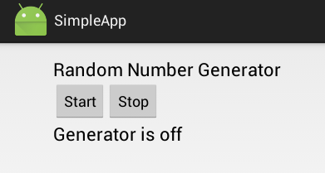
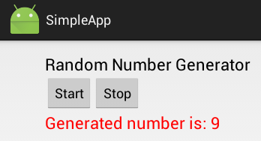
Exploring threads and thread communications
Our demonstration application
Continuous random number generation is our “long running work”
New number is displayed back to the UI
For simplicity, the UI is made from a single activity.
Download the demo code at:
https://bitbucket.org/jpwhite_mn/andevcon2015boston

Slide 5
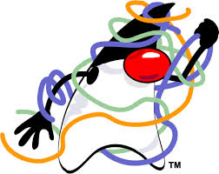

Default Android Process/Thread Behavior
By default,
Android starts a new Linux process for the application with a single thread of execution
All components of the same application run in the same process and thread
This thread is called the “main” thread or “UI” thread
Any updates to the UI/display must be accomplished on the main thread

Slide 6
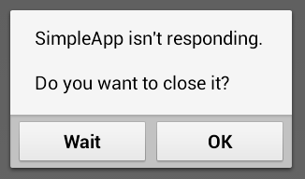
ANR
Android guards against apps that are not responsive
Application Not Responding error occurs when …
the application cannot respond to user input events.
no response to an input event within 5 seconds.
a broadcast receiver doesn’t finish processing within 10 seconds.
Example - the app is taking too much time downloading a file
The Android Activity Manager and Window Manager system services monitor for unresponsiveness.

Slide 7
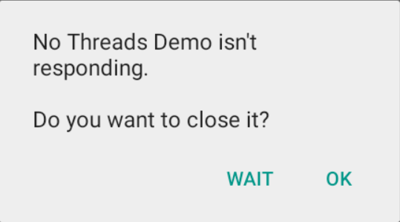
Demo App - no threading
In this demo
Start button gets clicked…
Click listener creates an instance of DoSomething…
Then calls DoSomething’s run() method
The run() method generates random numbers in an infinite loop and…
Publishes the generated number back onto the UI

Slide 8

How do we beat the clock?
5 Seconds!

Slide 9
Android Thread Options
Put non-UI work on a separate thread.
AsyncTask
Android’s built-in thread simplification mechanism
Convenience method for doing work on a separate thread
java.lang.Thread
Good-ole-fashion Java threading
You create and manage the separate thread
alternately - java.lang.HandlerThread

Slide 10
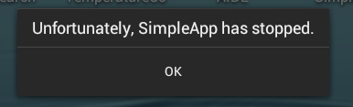

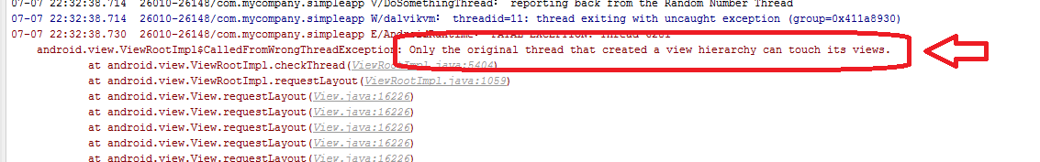
Catch-22 Frustration!!!
As you learn thread work, you learn of an issue.
The non-UI thread cannot make updates to the UI.
CalledFromWrongThreadException
Creating the conundrum…
A separate thread is needed for longer work
A separate thread can’t update the UI

Slide 11
Demo App – threading
In SimpleApp - CantUpdateUIFromThread
DoSomethingThread extends Thread
MainActivity displays the UI.
startButton’s onClick
Creates a DoSomethingThread
Starts the new thread (call to start).
DoSomethingThread thread tries to update the UI directly.
Note publishProgress method.

Slide 12

5 ways to communicate between Non-UI & UI threads
Use…
runOnUiThread(Runnable)
post(Runnable)
handler framework
broadcast / localbroadcast receiver
AsyncTask methods

Slide 13
Use the runOnUiThread(Runnable) method
This method calls to run a Runnable on the UI thread.
If the current thread is the UI thread, then the action is executed immediately.
If the current thread is not the UI thread, the action is posted to the event queue of the UI thread.
activity.runOnUiThread(new Runnable() {
@Override
public void run() {
// do your UI work here
}
});

Slide 14
Demo App – threading & runOnUiThread
In SimpleApp - Threaded-RunOnUIThread
Same creation of a new thread to do work (start generating random numbers) when the Start button is clicked.
Same publishProgress(int) is called each time a new random number is generated.
This time, publishProgress(int) uses runOnUiThread(Runnable) to update the UI.

Slide 15
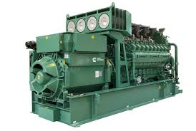
Using runOnUIThread with Runnable
1
create and start the thread
handler that was internally created
on receipt of Runnable, perform its work
3
Runnable
2
runOnUiThread( )
UI Thread’s Event Queue
Random Number Generator

Slide 16


runOnUiThread +/-’s
The runOnUiThread’s method is defined on the Activity class.
The non-UI thread must have some knowledge or means of getting the Activity.
Raises tight coupling and reuse concerns.
Developers need to know Threads, Runnables and concurrency issues.
How comfortable are you with Thread / Runnable API and the issues associated with it?
However the runOnUiThread() method is a convenience method that hides many of the details associated with event queue messaging.
Finally, the runOnUiThread comes with a nice feature.
If the runOnUiThread method is called from code running on the UI thread, it executes immediately and does not post a message into the event message queue.
This means you don’t have to check what thread you are running on when using this option.

Slide 17
Use the post(Runnable) method
This method also calls to run a Runnable on the UI thread.
Uses the same event message queue as runOnUiThread( ) does.
view.post(new Runnable() {
@Override
public void run() {
// do your UI work here
}
});

Slide 18
Demo App – threading and the post(Runnable)
In SimpleApp - Threaded-Post
Same creation of a new thread to do work (start generating random numbers) when the Start button is clicked.
Same publishProgress(int) is called each time a new random number is generated.
This time, post(Runnable) - on the TextView - is used to update the UI.

Slide 19

post +/-’s
The post() method uses the same event message queue under the covers as runOnUiThread().
Many of the pro/cons of post() are that of runOnUiThread().
See http://stackoverflow.com/questions/10558208/android-whats-the-difference-between-activity-runonuithread-and-view-post
post( ) must have awareness of a View component – again a tight coupling concern.
Allows the non-UI thread to avoid direct connection to the Activity.
As with runOnUiThread( ), requires you create and manage your threads more directly.
More control of the thread and its communication.
But requires more experience with Java concurrency/thread APIs and issues.
Unlike the runOnUiThread(), post() method does not check whether the current thread is the UI thread.
Therefore post() method does not execute immediately if it is on the UI thread.
It always has an event message pushed to the message queue for reaction by the UI thread.

Slide 20
Use the handler framework
Create a Handler on the UI thread.
Post a message to the handler on the non-UI thread (using the handler) when UI changes are needed
Allow the handler’s handleMessage( ) to update the UI on the UI thread when the message is processed.
//on the non-UI
Bundle msgBundle = new Bundle();
msgBundle.putString("result", text); // information for the update
Message msg = new Message();
msg.setData(msgBundle);
resultHandler.sendMessage(msg);
// on the UI thread from inside the Handler
@Override
public void handleMessage(Message message){
// update the UI
}

Slide 21
Demo App – threading and the handler framework
In SimpleApp - HandlerFramework
Same creation of a new thread to do work (start generating random numbers) when the Start button is clicked.
Create a new Handler (HandlerExtension) when the application is created (onCreate).
Same publishProgress(int) is called each time a new random number is generated.
This method creates a Message and uses the handler to send the message to the UI thread.
On the UI thread, the handler’s handleMessage(Message) updates the UI.
Note Weak Ref for the activity.
see http://stackoverflow.com/questions/11407943/this-handler-class-should-be-static-or-leaks-might-occur-incominghandler

Slide 22

Using the Handler Framework
onCreate()
2
1
Handler
create and start the thread
4
on receipt of message, update UI
via handleMessage()
new #
via sendMessage()
3
UI Thread’s Event Queue
Random Number Generator

Slide 23
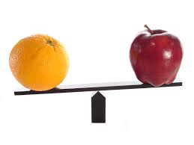
handler framework +/-’s
The runOnUiThread() and post() methods are really special Hander Framework conveniences.
They use the handler framework’s event queue on the UI thread to perform their task.
So why use the Handler Framework directly?
Using the Handler Framework is a bit more complex.
It allows more control – many more “posting” methods than shown here.
This is a generic framework for thread communication – any thread.
It also allows the non-UI thread to communicate without direct knowledge/ties to the activity or UI side components.
The non-UI merely has to post a message to a handler.

Slide 24
Use broadcast or localbroadcast receiver
Broadcast a message from the non-UI thread.
A broadcast receiver on the UI thread receives messages from the separate thread and updates the UI.
// on the non-UI thread
Intent intent = new Intent("com.mycompany.random.generation");
intent.putExtra("result", text);
LocalBroadcastManager.getInstance(MainActivity.this).sendBroadcast(intent);
// on the UI thread from inside the BroadcastReceiver
@Override
public void onReceive(Context context, Intent intent) {
// update the UI
}

Slide 25
Demo App – threading and broadcasts
In SimpleApp - Broadcast
Same creation of a new thread to do work (start generating random numbers) when the Start button is clicked.
Create and register a new BroadcastReceiver when the application is created (onCreate).
Same publishProgress(int) is called each time a new random number is generated.
It uses a LocalBroadcastManager to send a broadcast (on the non-UI thread)
The receiver, updates the UI on the UI thread.

Slide 26
Using Broadcast Receiver
onCreate()
on receipt of intent, update UI
via onReceive()
5
1
Broadcast Receiver
new #
via sendMessage()
2
create and start the thread
Android OS
3
4
new #
Intent with the new #
via sendBroadcast()
Random Number Generator
LocalBroadcastManager

Slide 27
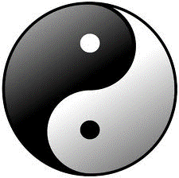
broadcast receiver +/-’s
The broadcast option is not reliant on the message event queue.
Instead it relies on a different set of components.
Namely the Intent and Intent listener called a broadcast receiver.
This sub-framework has its own + and –’s.
No convenience methods as with post() & runOnUiThread() that use the event queue.
Some consider working with Intents, BroadcastReceivers & LocalBroadcastManager a bit more complex.
However, the broadcast intent can conveniently carry quite a bit of data to the UI thread from the non-UI thread.
The non-UI thread and UI thread do not have to share any component knowledge – loose coupling.

Slide 28
Use the AsyncTask
Create a class that extends AsyncTask.
From the doInBackground( ) - which executes on the non UI-thread – call on onProgressUpdate( ) to update the UI.
This causes its onProgressUpdate( ) method to be called – which executes on the UI thread.
// on the non-UI thread’s doInBackground
@Override
protected Void doInBackground(Void... params) {
//do non-UI work
publishProgress(text); // call to update the ui
}
// on the UI thread’s onProgressUpdate
@Override
protected void onProgressUpdate(String... values) {
//update the UI
}

Slide 29
Demo App – AsyncTask
In SimpleApp - AsyncTask
Notice inner AsyncTask class (versus Thread class)
An instance gets created and started with a call to execute( ) when the Start button is pressed.
It’s doInBackground( ) method generates the random numbers and calls to update the UI with publishProgress( ).
In the publishProgress( ) it updates the UI.

Slide 30

AsyncTask +/-’s
The AsyncTask is a real convenience for Android developers.
Allows for multithreading without having to think about all the communications across threads
Without having to think about Runnables, Thread instances, special methods to call, queues, etc. to get the work done.
The convenience of the three UI-thread methods makes getting information across the thread boundary easier.
However, the AsyncTask is fairly basic.
When more complex multithreading needs arise, it may be too simple to use.
The documentation is pretty clear about when to use AsyncTask and when to move to something else.
“AsyncTasks should ideally be used for short operations (a few seconds at the most.) If you need to keep threads running for long periods of time, it is highly recommended you use the various APIs provided by the java.util.concurrent package such as Executor, ThreadPoolExecutor and FutureTask.”
In this example, the AsyncTask was built as inner class to the Activity.
The AsyncTask can be a completely separate class with no ties to the Activity or other UI component.
This allows the non-UI threads to be completely decoupled from the UI.

Slide 31
Wrap Up
You now know Android’s default thread situation.
You have seen the issues associated with doing too much work on the UI thread or the wrong thread
ANR and CalledFromWrongThreadException
You have seek the options for Android thread creation.
AsyncTask and java.lang.Thread
You learned how to handle non-UI thread to UI thread communications.
runOnUiThread( )
post( )
The Handler framework
Broadcasts and BroadcastReceiver
AsyncTask
You know how to evaluate the options and pick the best solution for your app needs

Slide 32

eventmobi.com/adcboston
Please take a moment to fill out the class feedback form via the app. Paper feedback forms are also available in the back of the room.

Slide 33
Thank you
Enjoy the rest of the conference!
Don’t forget to fill out the evaluation sheet.
jpwhite_mn@yahoo.com

